Slide 1
The Smartest Apple Ecosystem
By: Kairatbekuly Umbet

Slide 2
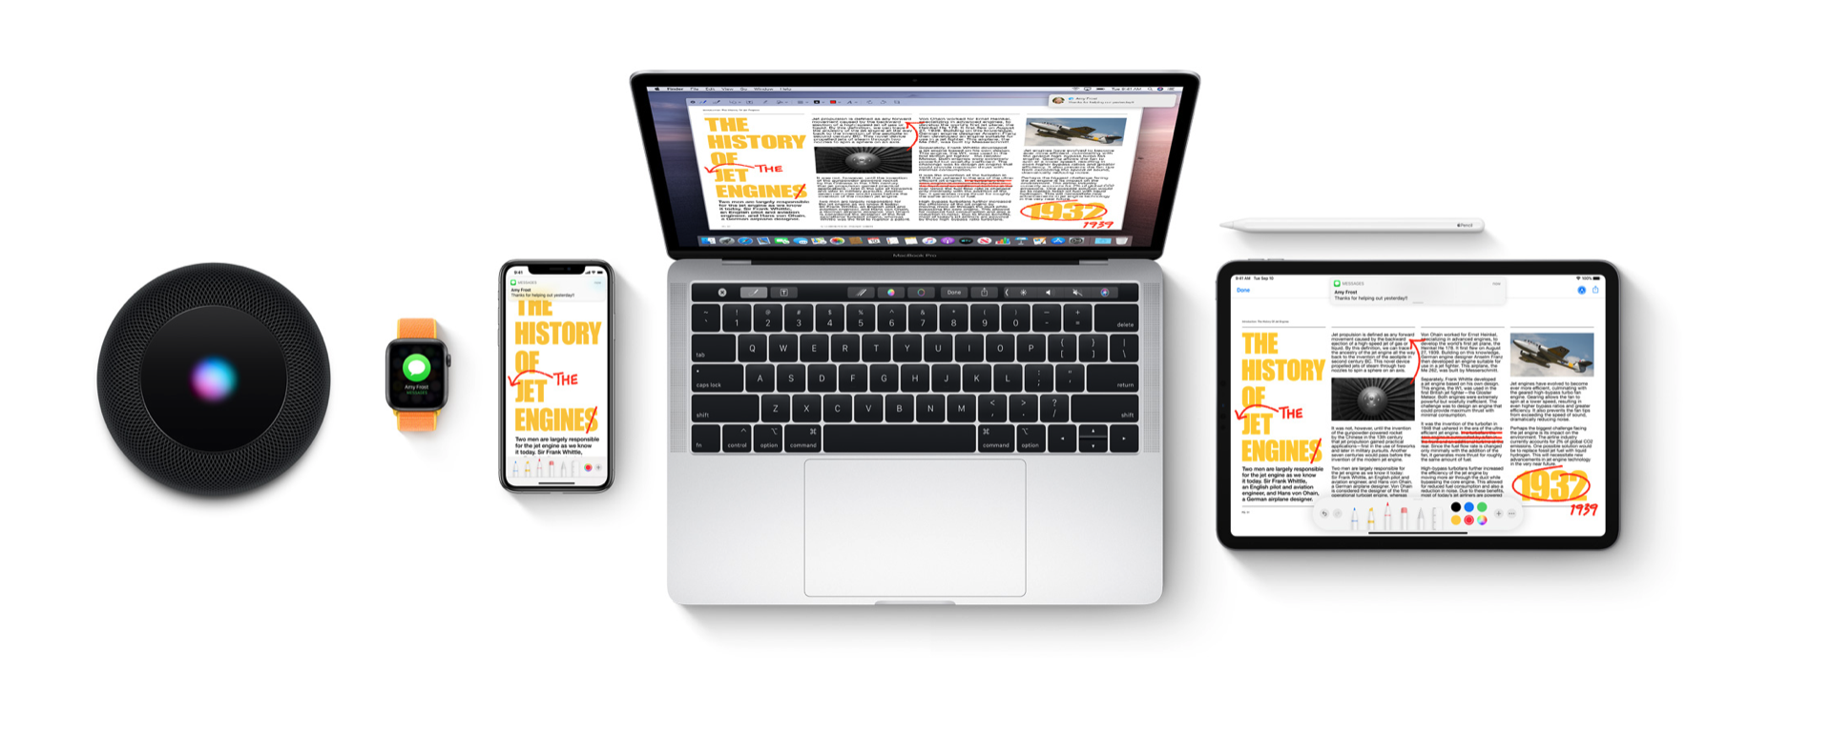

What really is the Apple Ecosystem?

Slide 3
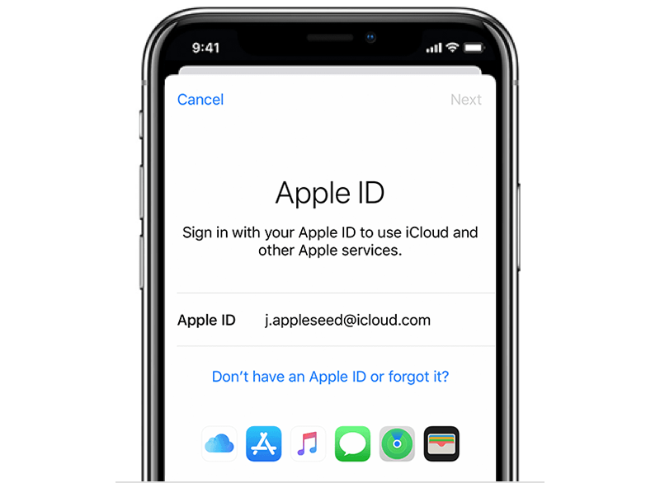
Apple ID
The back bone of the entire Apple Ecosystem is the Apple ID. The Apple ID is used to register all of your Apple devices. From there, Apple will not know how many devices you know, but see if they are nearby and if the nearby devices are a part of your contact circle. Information like this means that the device will be accessible to your or someone related to you.

Slide 4
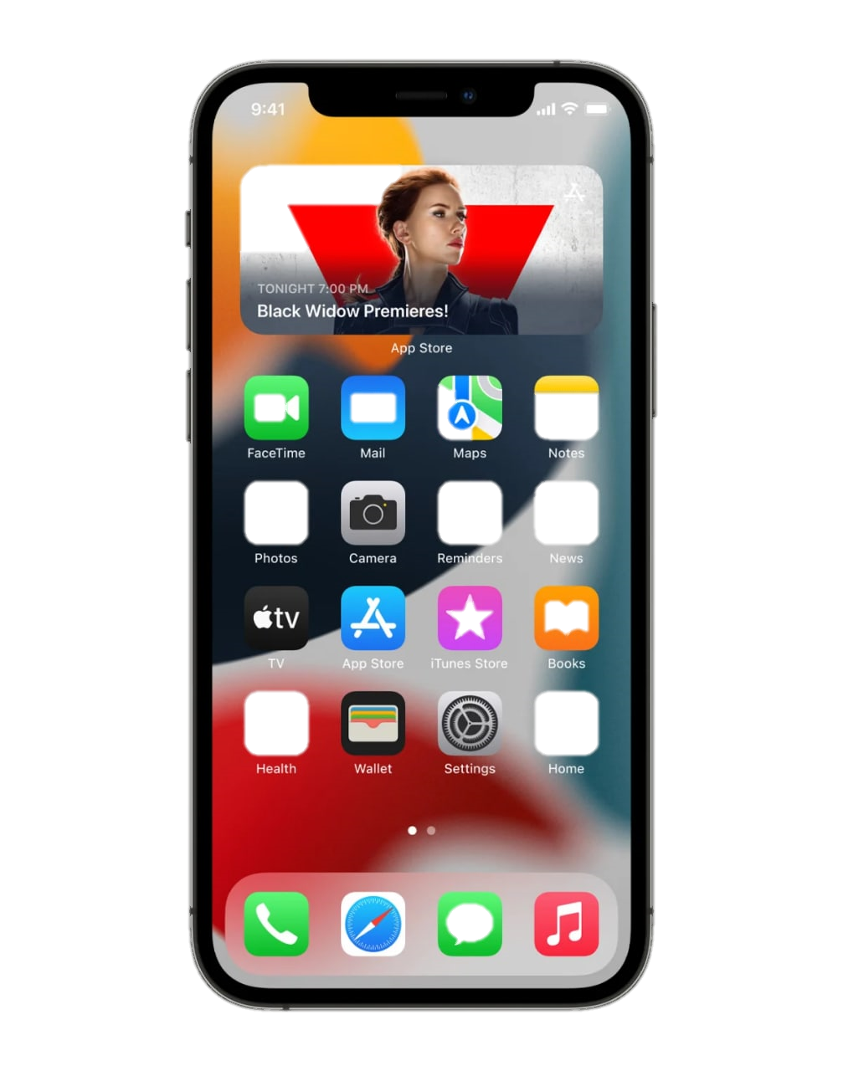
iPhone
The iPhone is a smartphone made by Apple that combines a computer, iPod, digital camera and cellular phone into one device with a touchscreen interface.

Slide 5
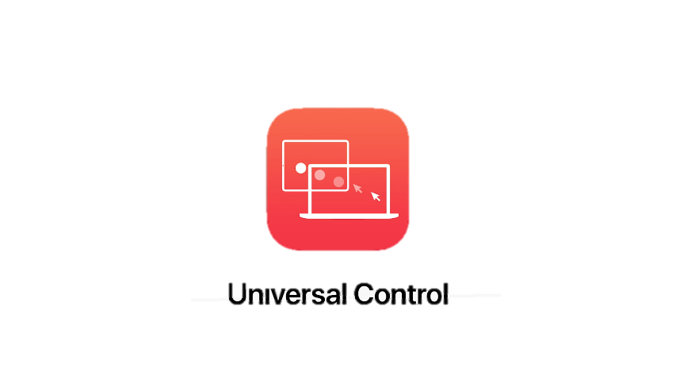
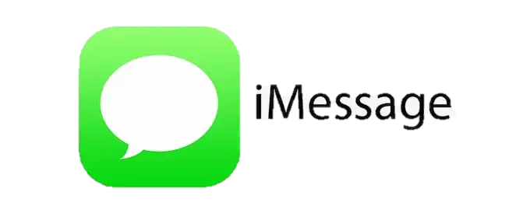
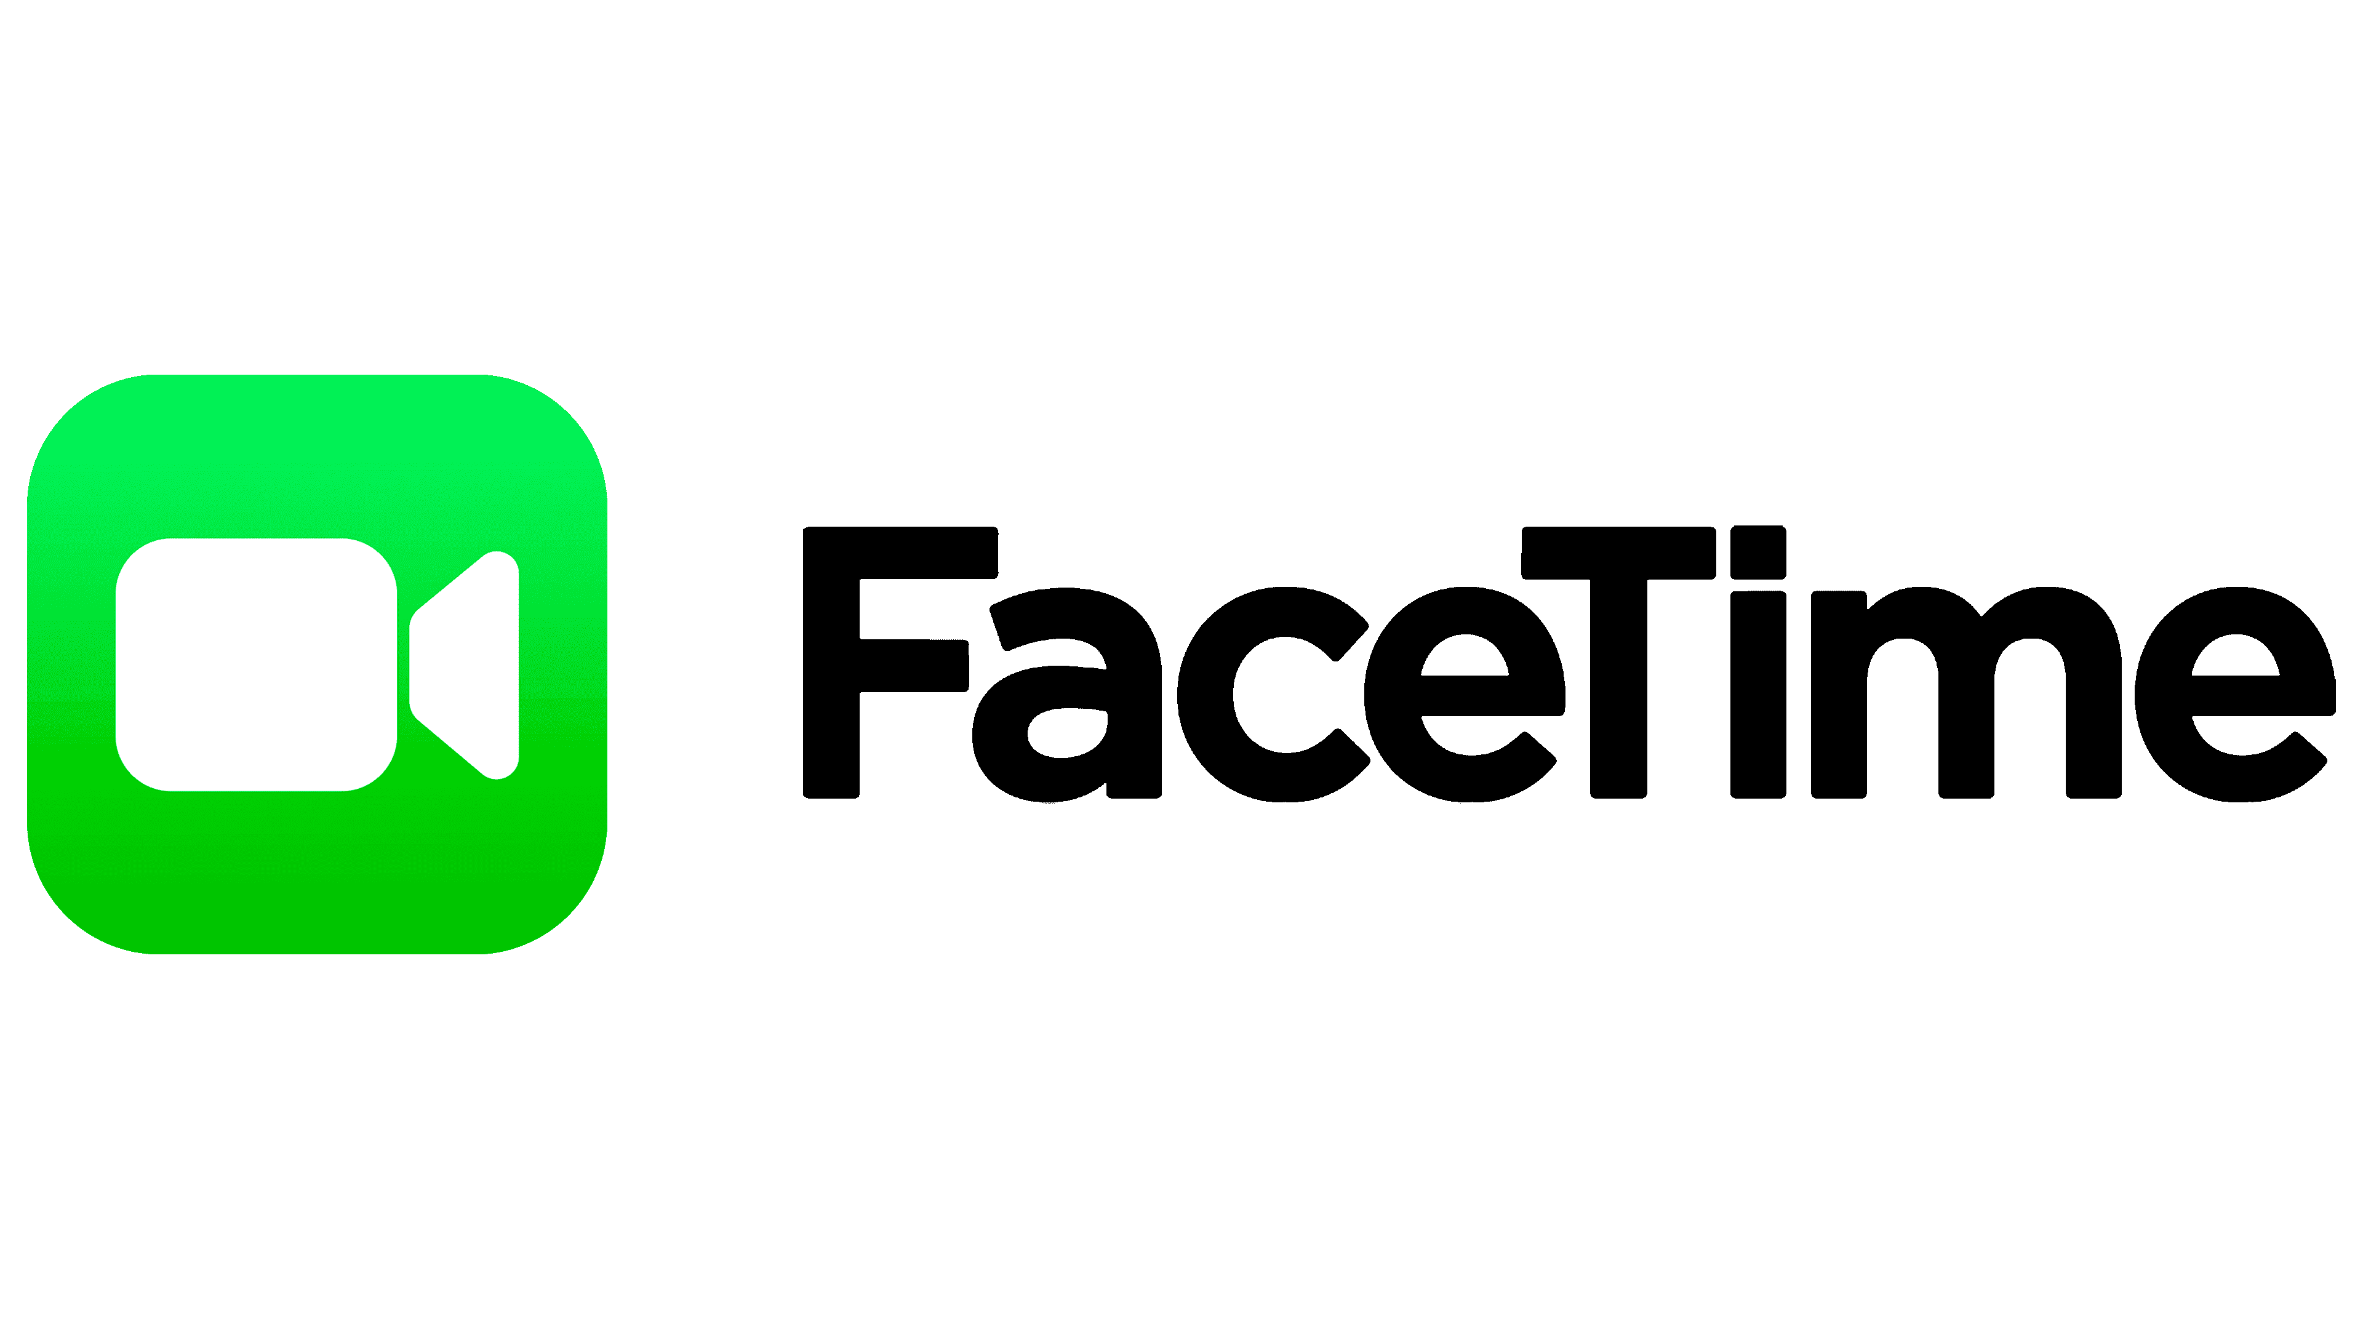
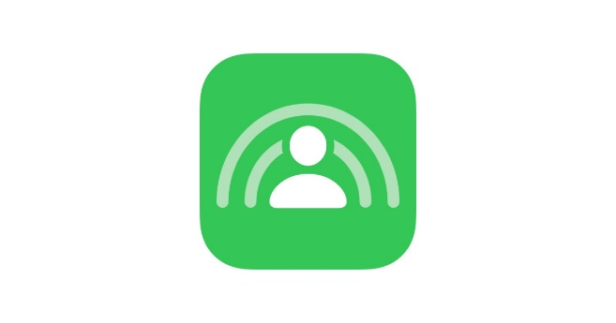
Examples of ecosystem Features
SharePlay

Slide 6
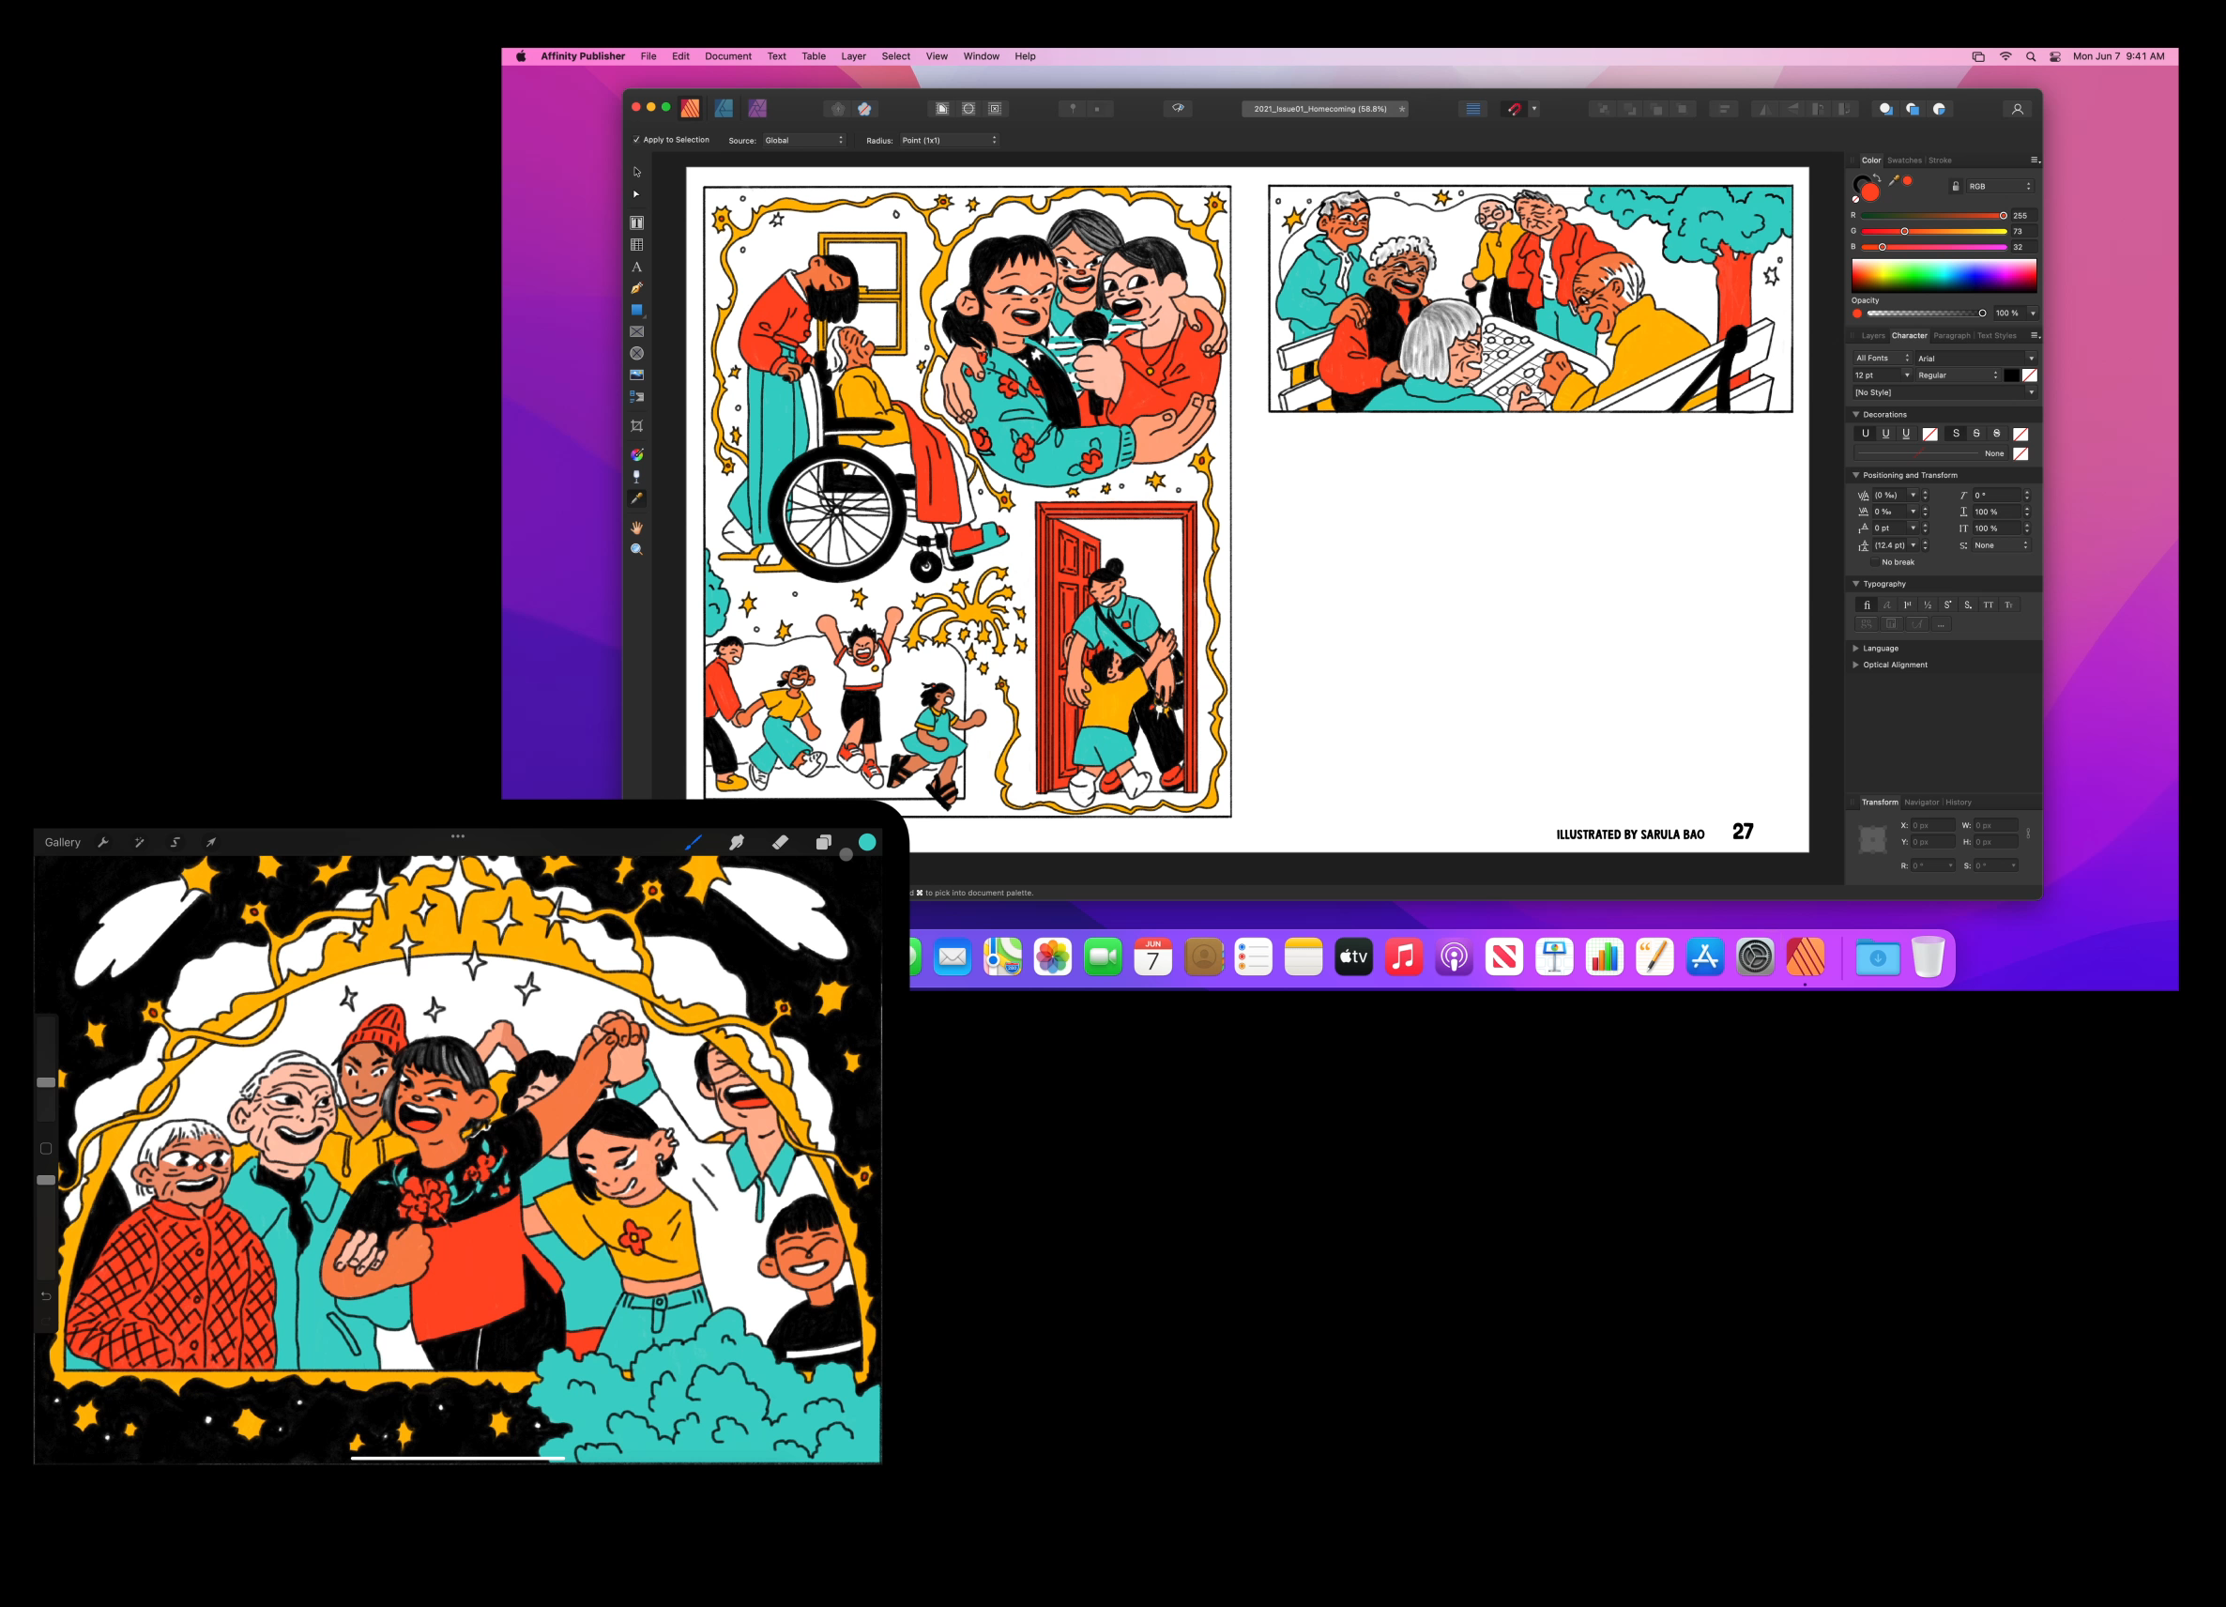

Universal Control
Universal Control in macOS Monterey. Notice how well iPadOS and macOS is integrated

Slide 7

iMessage
iMessage is another best example of the Apple ecosystem works perfectly. All of your messages are available on your devices and other people who are in the same ecosystem have a very rich set of features like video calling, messages that come in text, audio or video and even watching the same thing using SharePlay.

Slide 8
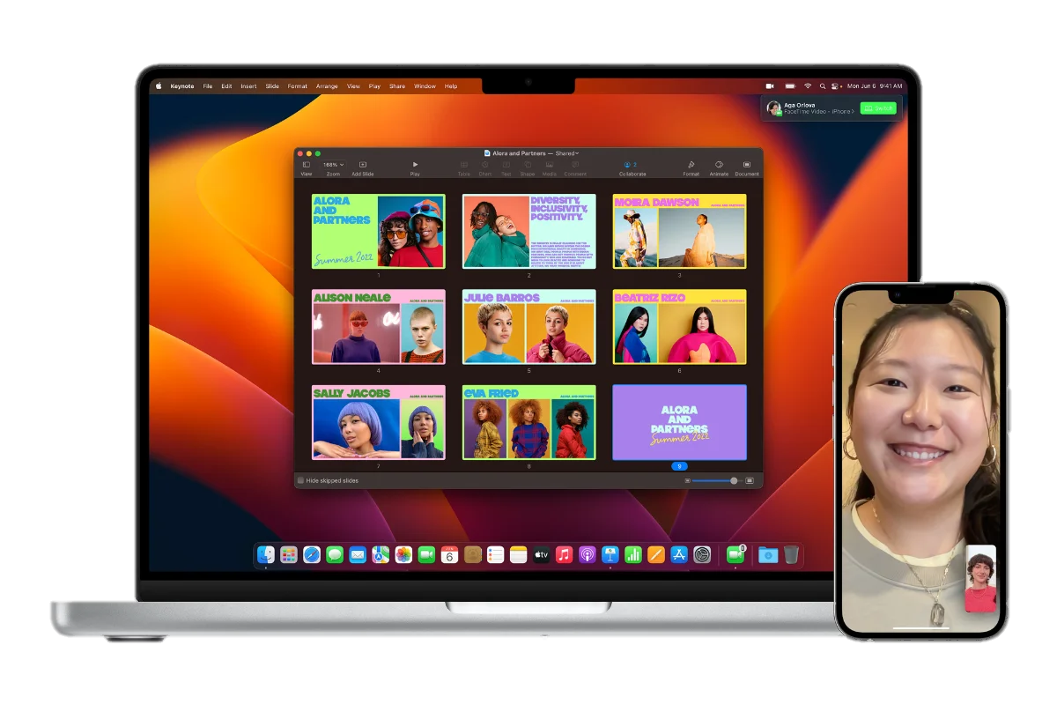
Easily switch between devices during a FaceTime call. To do this, the devices has to be aware for each other.

Slide 9
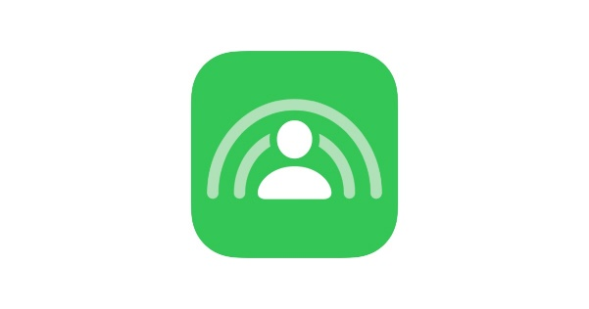
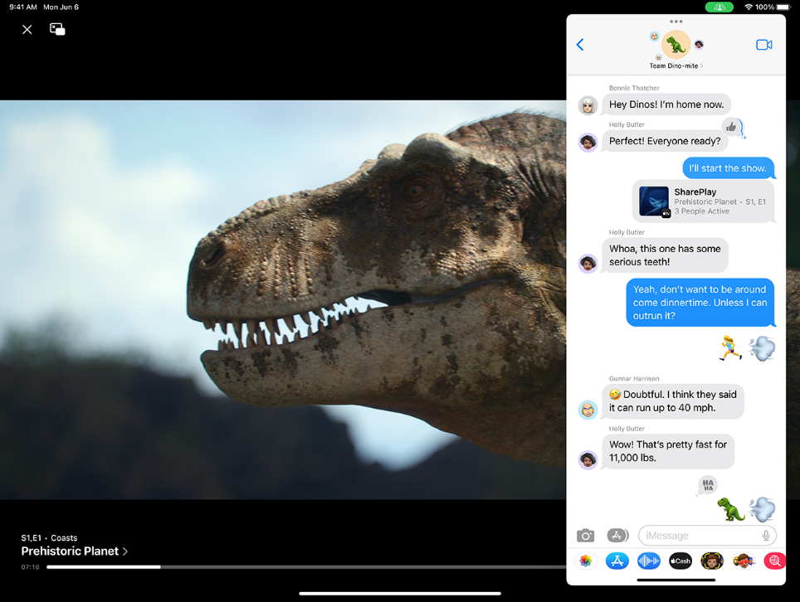
SharePlay
Apple SharePlay: an example of harnessing the power of the ecosystem. Chat with your friends on iPhone and when you get a shared video, from your friends in your group, you can play the video on your Apple TV

Slide 10
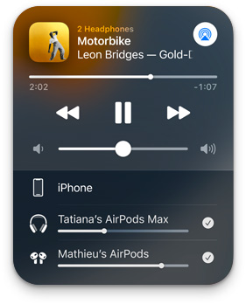
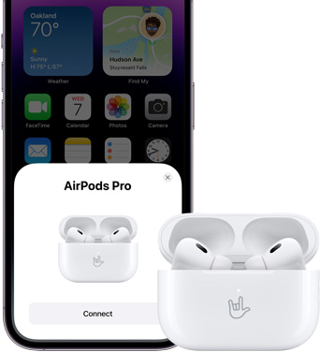
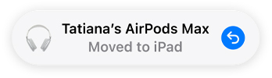
A magical connection to your devices
Audio Sharing
Automatic switching
One-tap setup

Slide 11
Thanks for watching!

